Slide 1

BIA 610 - Applied Analytics
Prof. Victor Moya
Data Analytics for Laundry Business Expansion
Raj Mahajan
Kavit Shah
Shubham Shrivastava

Slide 2
Introduction
An existing laundry chain wants to build a vast network in small cities within the US to maximize profit and to avoid competition with big players in major cities.
The company is already located in 140 locations and recently opened stores in 10 new cities. They want to identify which of the 10 new locations have the best potential for the company to invest more funds into marketing.
We are addressing the problem using Tableau by implementing clustering, building trend lines and regression to identify the location that would provide the most profit.

Slide 3
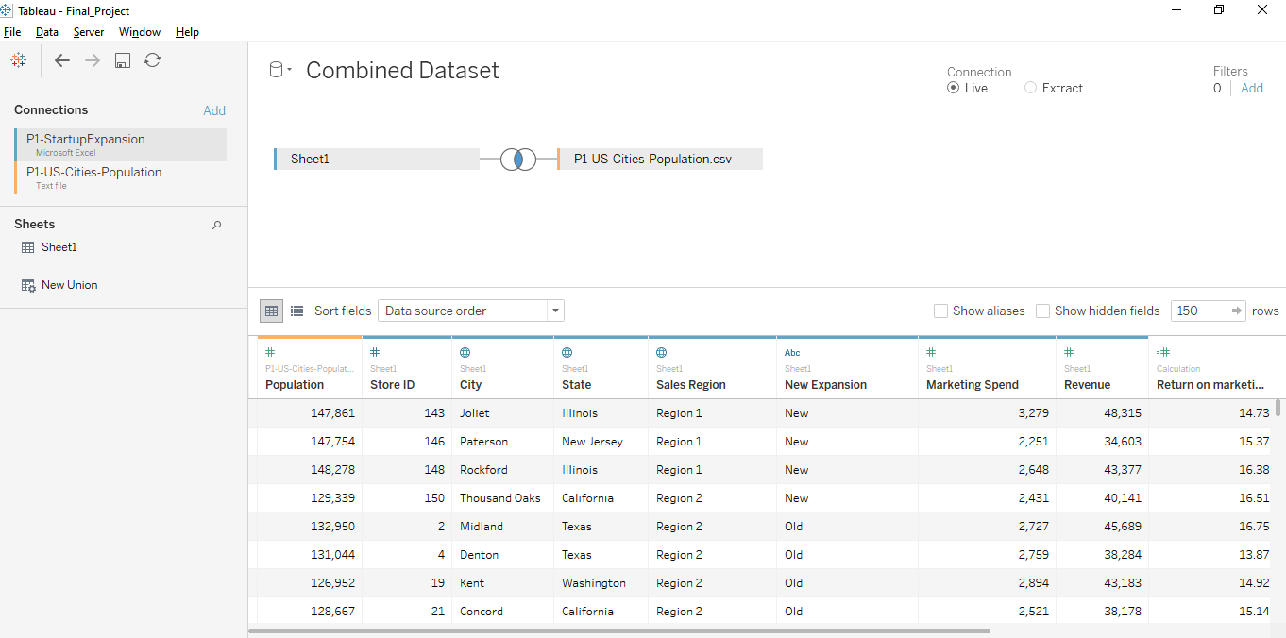
Dataset for analysis
There is the blend of 2 datasets:
1.Revenue Dataset
2.Population Dataset

Slide 4
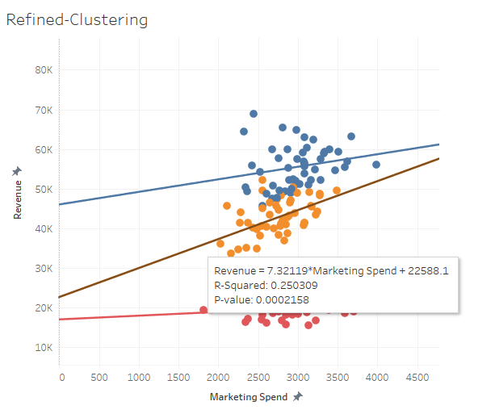
Modeling
The refined cluster analysis shows that the Yellow line is the most profitable for the company.
The line signifies a profit of $7.32 for every dollar spend.
It can be noted from the world map worksheet, most of the new highly profitable stores of the company lie in California.
The model would play a significant role in developing marketing strategy for the firm and also for opening more stores in the future.

Slide 5
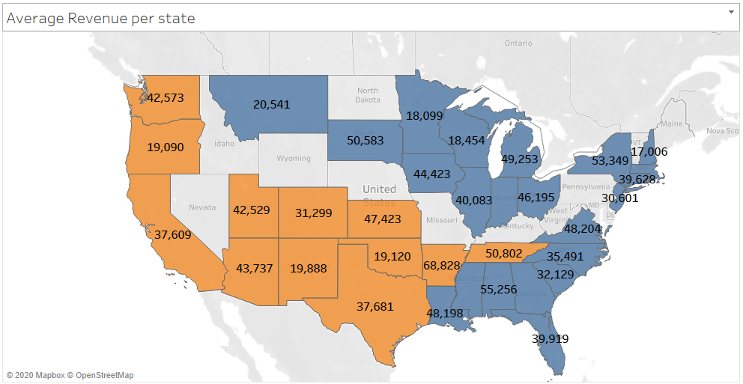
Average Revenue per State
Here we can see the average Revenue per State of the Laundry Startup in USA
The Sales Regions in Later Divided into colours

Slide 6
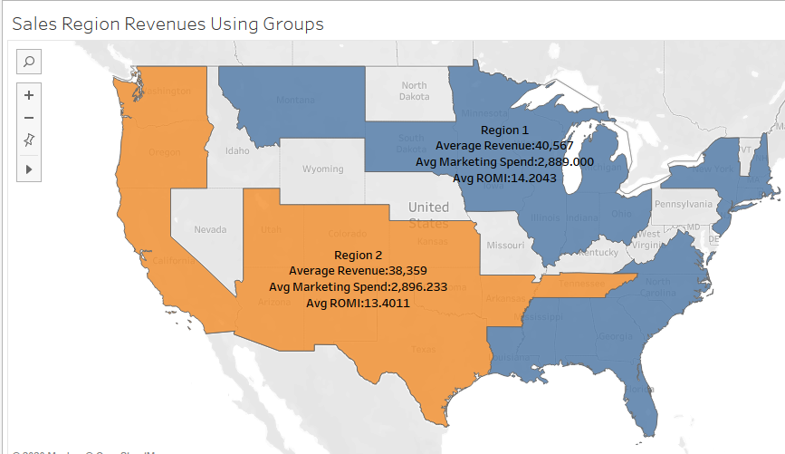
Sales Region Revenues
Here the different sales regions’ revenue is bifurcated using group function in Tableau to get a better idea of the network of the Laundry Startup.

Slide 7
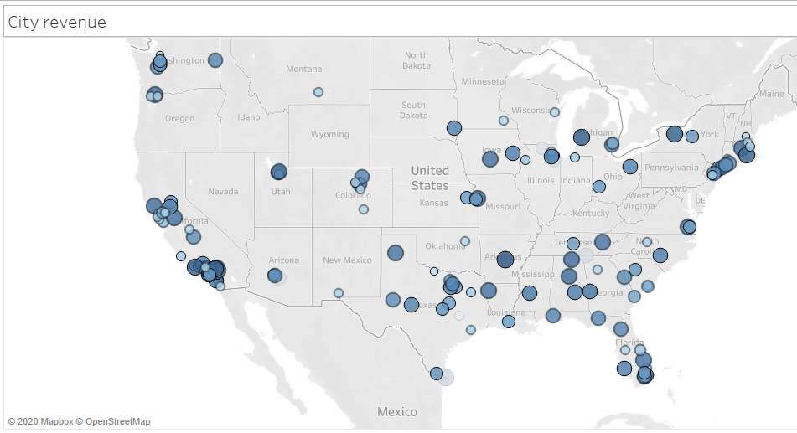
City Revenues
Here we increase our level of Granularity by adding the cities with their contribution to the revenue.
We use the highlight feature to select from 140 old cities or 10 new cities.

Slide 8
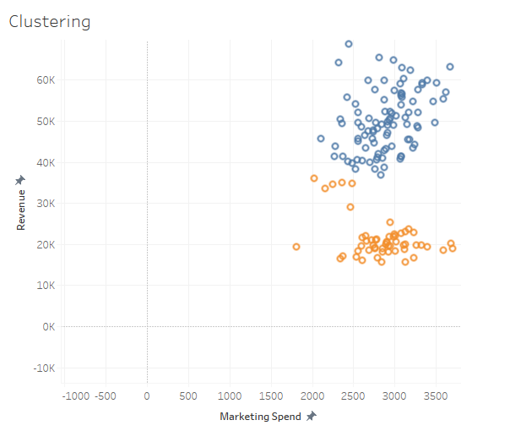
Clustering
We have done simple clustering between Revenue and Marketing spend but as the startup like this depends more on the number of people it is necessary for us to include population as a factor too. Therefore we need to refine the cluster further.

Slide 9
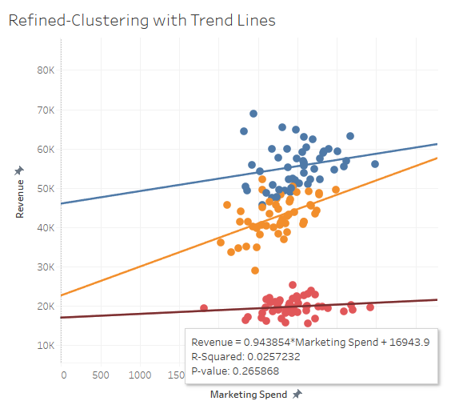
Refined Clustering with Red Trend Lines
For this refined clustering, we have included population as a factor too and the trend line helps us see different cities with the potential to invest.
The red trend line signifies that for every $1 spent on marketing the returns are $0.934 which is not good.

Slide 10
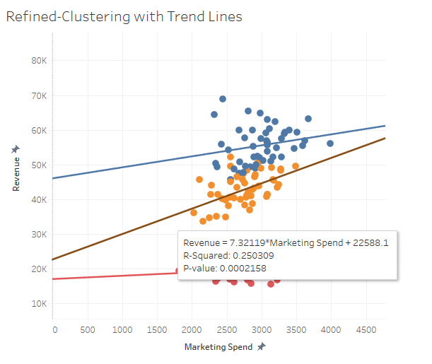
Refined Clustering with Yellow Trend Line
Now for the Yellow Line, it signifies that for every $1 spent on marketing the returns $7.32 which is high and profitable.
Compared to the remaining lines it is the best trend line which tells us about the cities which have high potential to invest in marketing funds.

Slide 11
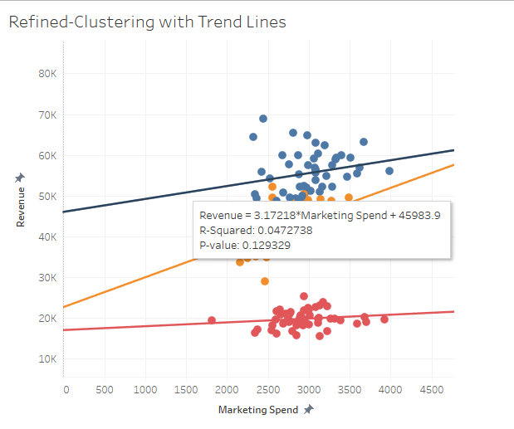
Refined Clustering with Blue Trend Line
For the blue trend line where the population is the maximum, it signifies that for $1 spent on marketing the returns are $3.17 which is good but not that good enough as the yellow line.
So these trend lines help us select the new cities which are available or have the potential to invest the money for marketing.

Slide 12
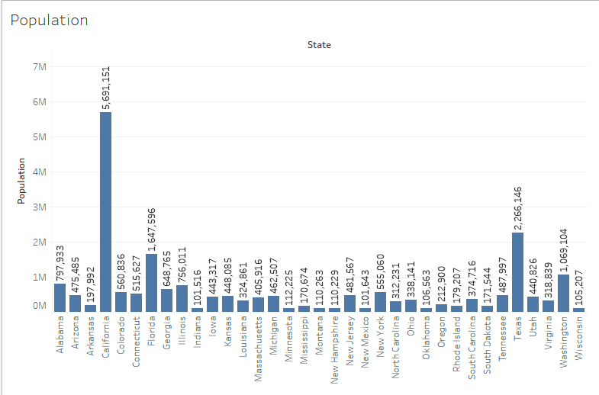
Population graph of States
The bar graph shows population of every US state.
The data is taken from US cities Population Dataset

Slide 13
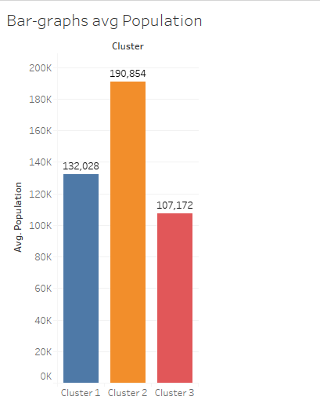
Bar Graph for Average Cluster Population
The clusters made earlier in the project are now used as a dimension so that we can visualize the average population of these clusters.

Slide 14
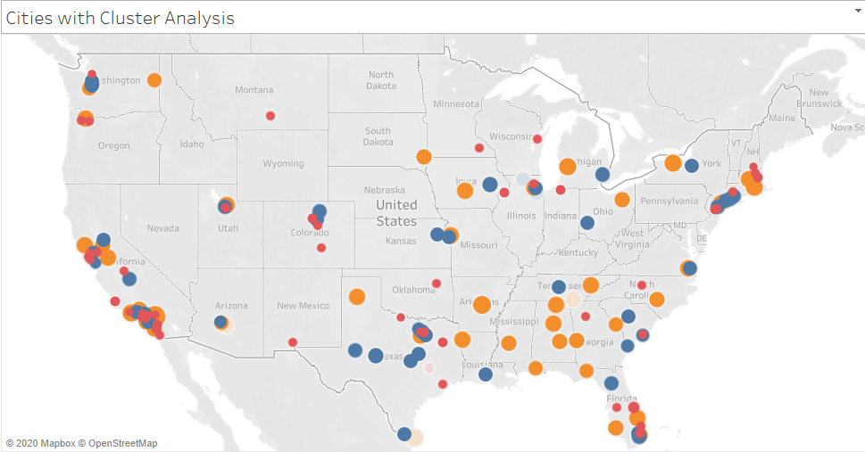
Cities with Cluster Analysis
Finally, we have used the cluster dimension and marked the cities which fall in the category of the clusters and have used the highlight function to highlight the cities accordingly.

Slide 15
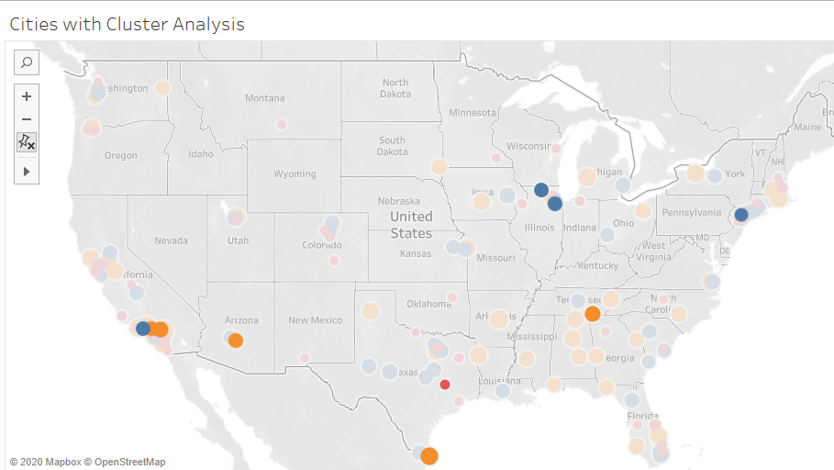
Cities with Cluster Analysis
So now we have the final new cities which contribute to the Returns on Investments. The cities in blue and Yellow have the highest returns on marketing investments.
The cities are as follows:
1. Tempe, Arizona
2. Glendale, California
3. Rancho Cucamonga, California
4. Brownsville, Texas
5. Chattanooga, Tennessee
6. Joilet, Illinois
7. Rockford, Illinois

Slide 16

Deployment
After successful tableau representation, the report consisting of the findings would be handed over to the board of directors to help them make the decision regarding where to invest more funds for marketing.

Slide 17

Deployment - Risk Factors
Pandemic Outbreaks such as Covid-19
Old Census Data Set of Population - 2015
Variance in State-wise laws and regulations

Slide 18

References
https://sds-platform-private.s3-us-east-2.amazonaws.com/uploads/P1-StartupExpansion.xlsx
https://sds-platform-private.s3-us-east-2.amazonaws.com/uploads/P1-US-Cities-Population.csv

Slide 19
Appendix
Shubham Shrivastava
Business understanding and the Data Preparation task for the project
Kavit Shah
Evaluation and the tableau presentations for the project
Raj Mahajan
Modeling and Deployment for the project

Slide 20
Thank You !

